Slide 1
Routing Overview

Slide 2
Routing Overview
Network routing is the process of selecting the best path for data to travel across one or more networks.
It plays a vital role in the internet by ensuring that data packets reach their correct destination efficiently.
Routing determines the path IP packets follow from source to destination.
It is used in packet-switched networks like the Internet.
Different routing methods are used to optimize speed, reliability, and performance.

Slide 3
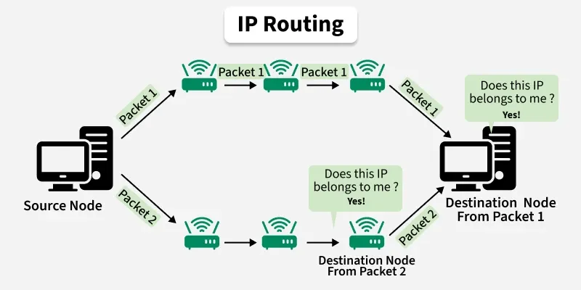
Routing of a data packet is done by analyzing the destination IP Address of the packet
The Source Node (Sender) sends the data packet on the network, embedding the IP in the header of the data packet.
The nearest router receives the data packet, and based on some metrics, further routes the data packet to other routers.
Step 2 occurs recursively till the data packet reaches its intended destination.
Note: There are limits to how many hop counts a packet can do if it is exceeded, the packet is considered to be lost.

Slide 4
Different Types of Routing
Routing is typically of 3 types, each serving its purpose and offering different functionalities:
Static Routing
Dynamic Routing
Default Routing

Slide 5
Static Routing
Static routing is a non-adaptive routing method where routes are configured manually by the network administrator:
It provides complete control over routing decisions but is best suited for small networks.
Routes are added manually
Full control over packet routing
Simple but hard to manage in large networks

Slide 6
Static Routing
Static routing is useful in networks that have a single path to any destination network.
Static routing reduces the memory and processing burdens on a router.
To configure static routing on a Cisco router, use the ip route command. This command uses the following syntax:
  Router(config)#ip route destination-network destination-netwok-mask {next-hop-ip address | interface} [distance] [tag tag] [permanent]

Slide 7
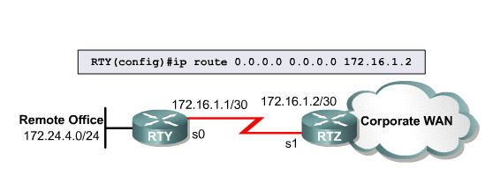
Configuring Static Default Routes

Slide 8
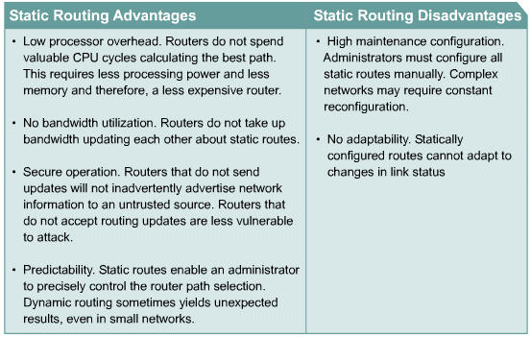
Advantages and Dis-Advantages of Static Routing

Slide 9
Dynamic Routing
Dynamic routing is an automatic and adaptive routing method where routers choose paths using algorithms.
It is widely used in modern networks due to its flexibility.
Routes update automatically
Adapts to network changes
Suitable for large networks

Slide 10
Dynamic Routing
Dynamic routing of TCP/IP can be implemented using one or more protocols which are often grouped according to where they are used.
Routing protocols designed to work inside an autonomous system are categorized as interior gateway protocols (IGPs).
Protocols that work between autonomous systems are classified as exterior gateway protocols (EGPs).
Protocols can be further categorized as either distance vector or link-state routing protocols, depending on their method of operation.

Slide 11
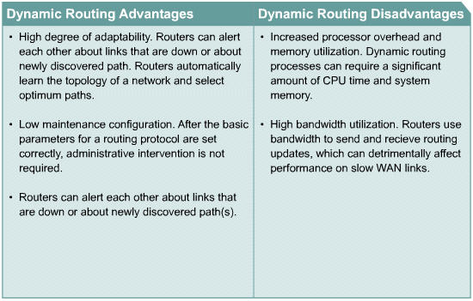
Advantages and Dis-Advantages of Dynamic Routing

Slide 12
Default Routing
Default routing sends packets to a predefined gateway when no specific route is available. It is commonly used in networks with a single exit point.
Used when no route is found
Simple and efficient setup
Default route: 0.0.0.0/0

Slide 13
Working Principle of Routing
Routing works by finding the shortest path from the source node to the destination node across a network. Here's the step-by-step working of routing:
Step 1: Communication Start - A device (client or server) starts communication using the HTTP protocol.
Step 2: Data Packets: The data is broken into small packets. Each packet is tagged with the destination IP address.
Step 3: Routing Table - Routers use a routing table to find the best and shortest path to the destination.
Step 4: Hopping - Packets travel through multiple routers (hops) to reach the destination. There is a limit on the number of hops; if exceeded, the packet is dropped and retransmitted.
Step 5: Destination - Packets reach the destination, are reassembled, and checked for errors.

Slide 14
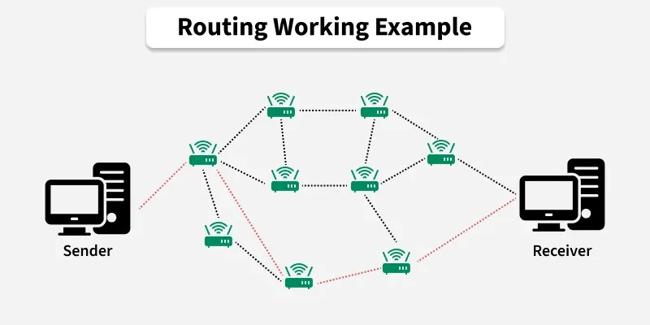
Routing Working Examples
In this image, we have 3 major components:
Sender
Receiver
Routers
The shortest path is highlighted in red, the path with the least hop count.
As we can see, there are multiple paths from source to node but if all the appropriate metrics are satisfied, the data packets will be transmitted through the shortest path (highlighted in red).

Slide 15
Main Routing Protocols
RIP (Routing Information Protocol): It is a distance-vector protocol that uses hop count as a metric.
OSPF (Open Shortest Path First): OSPF is a link-state protocol that finds the shortest path using the Dijkstra algorithm.
EIGRP (Enhanced Interior Gateway Routing Protocol): It is a hybrid protocol that combines features of distance-vector and link-state.
BGP (Border Gateway Protocol): It is a path-vector protocol that is used for routing between different autonomous systems on the internet.
IS-IS (Intermediate System to Intermediate System): It is a link-state protocol that is primarily used in large networks like ISPs.

Slide 16
Methods of operation for Routing Protocols
The purpose of routing protocols is to learn about all the available paths to route data packets, build routing tables, and make routing decisions based on specified metrics.
There are two primary Operations of routing protocols

Slide 17
Distance Vector Routing
In this type of routing protocol, all the nodes that are a part of the network advertise their routing table to their adjacent nodes (nodes that are directly connected) at regular intervals.
With each router getting updated at regular intervals, it may take time for all the nodes to have the same accurate network view.
Uses fixed length sub-net, not suitable for scaling.
Algorithm used: Bellman Ford Algorithm to find the shortest path.

Slide 18
Link State Routing
Link State Routing is a type of dynamic routing protocol where routers send updates only when there is a change in the network, saving bandwidth.
Routers share information about links such as cost and hop count to find the best path.
It uses Variable Length Subnet Mask (VLSM) for better and scalable addressing.
It uses Dijkstra’s Algorithm to calculate the shortest path.

Slide 19
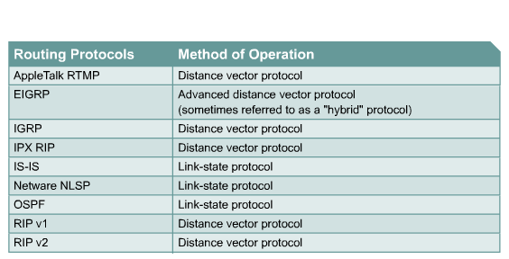
Summary

Slide 20
Advantages of Routing
Routing: Helps send data efficiently by choosing the best path.
Automated Routing: Uses algorithms to reduce manual work but gives less direct control.
Manual Routing: Provides better control but requires more effort to manage.
Scalable Routing: Works well for large networks and supports load balancing to reduce traffic and data loss.

Slide 21
Disadvantages of Routing
Static Routing: Suitable only for small networks; difficult to manage and less secure in large networks.
Dynamic Routing: Offers less manual control and uses more bandwidth and system resources.
Default Routing: Easy to use but can cause issues if the default path is not properly configured.

Slide 22
Routing Metrics
The cost between nodes is measured using different routing metrics.
Hop Count: The number of nodes a data packet passes through to reach its destination. Fewer hops mean a shorter and faster path.
Bandwidth Consumption: Routing selects paths that use network bandwidth efficiently to avoid congestion.
Delay: The time taken by a data packet to travel from source to destination. Routing aims to reduce delays.
Load: Refers to how busy a network path is. Packets are sent through less busy paths for faster delivery.
Reliability: Routing chooses stable and available paths to ensure data reaches its destination safely.

Slide 23
Convergence Issues
Factors affecting the convergence time include the following:
  Routing protocol used
  Distance of the router, or the number of hops from the point of change
  Number of routers in the network that use dynamic routing protocols
  Bandwidth and traffic load on communications links
  Load on the router
  Traffic patterns in relation to the topology change

Slide 24
Route Calculation Fundamentals
The capability of a routing protocol to update and calculate routes efficiently is based on several factors:
  Whether the protocol calculates and stores multiple routes to each destination.
  The manner in which routing updates are initiated.
  The metrics used to calculate distances or costs.

Slide 25
The Initiation of Routing Updates
Routing protocols can instruct a router to update neighbors after a specific amount of time has passed, after a certain event has occurred, or both.
Time-driven routing protocols wait for the update timer to expire and then send an update.
Protocols that are event-driven do not require the router to update neighbors until the router detects a change in the network topology.
Routing protocols that are exclusively time-driven react poorly to topology changes.
Routing protocols that are exclusively event-driven could go for extended periods of time without sending updates.

Slide 26
LAB
Configuration of Dyanamic Routing-RIP

Slide 27
Introduction to EIGRP

Slide 28
EIGRP
Improved Interior Gateway Routing Protocol (IGRP)
Hybrid
  More like distance vector, but with some link state ideas
Scalable
Support for Classless inter-Domain Routing (CIDR) and Variable Length subnet Mask(VLSM)
Multi-protocol support
  PDMs (protocol dependant modules)
Rapid convergence with DUAL
Partial, bounded updates

Slide 29
EIGRP Features
  Cisco proprietary and is Hybrid: (containing Advanced distance vector and several link-state features)
  Fast convergence : stores all its neighbors’ routing tables so that it can quickly adapt to alternate routes. If no appropriate route exists, EIGRP queries its neighbors to discover an alternate route which continues until an alternate route is found.
  Support for VLSM and discontiguous subnets: as a classless routing protocol, EIGRP advertises a subnet mask for each destination network; enabling it to support dis contiguous subnet works and VLSM. Routes are automatically summarized at the major network number boundary, and can be configured to summarize on any bit boundary on any router interface.

Slide 30
Cont’d
  Partial updates: Sends partial triggered updates as opposed to periodic updates--sent only when the path or metric changes containing information about the changed route. For this reason EIGRP consumes significantly less bandwidth than IGRP. This behavior is different than that of link-state protocols, in which an update is transmitted to all link-state routers within an area.
  Support for multiple network-layer protocols: EIGRP supports IP, AppleTalk, and Novell NetWare Internet Packet Exchange (IPX) through the use of protocol-dependent modules. The rapid convergence and sophisticated metric structure of EIGRP offers superior performance and stability when implemented in IPX and AppleTalk networks.

Slide 31
Cont’d
  Flexible network design
  Multicast and unicast instead of broadcast address: EIGRP uses multicast and unicast, rather than broadcast. The multicast address used for EIGRP is 224.0.0.10.
  Manual summarization at any point
  100% loop-free classless routing
  Easy configuration for WANs and LANs
  Load balancing

Slide 32
EIGRP Key Technologies
Neighbor discover/recovery: Uses Hello packets between neighbors
Reliable Transport Protocol (RTP): Guaranteed, ordered delivery of EIGRP packets to all neighbors
DUAL finite-state machine: Selects lowest-cost, loop-free, paths to each destination
Protocol-dependent modules (PDMs) : EIGRP supports IP, AppleTalk, and Novell NetWare; Each protocol has its own EIGRP module and operates independently from any of the others that may be running
Notes:
Neighbor discovery/recovery -- Uses Hello packets between neighbors.
Reliable Transport Protocol (RTP) -- Guaranteed, ordered delivery of EIGRP packets to all neighbors.
DUAL finite-state machine -- Selects lowest-cost, loop-free, paths to each destination
Protocol-dependent modules (PDMs) -- EIGRP supports IP, AppleTalk, and Novell NetWare; Each protocol has its own EIGRP module and operates independently from any of the others that may be running.

Slide 33
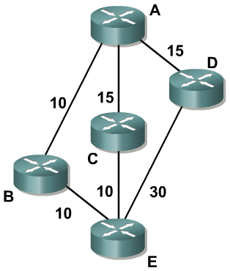
The Diffusing Update Algorithm (DUAL)
How does EIGRP determine which routes are loop-free?
Each of A’s neighbors is
reporting reachability to E:
  B with a cost of 10
  C with a cost of 10
  D with a cost of 30
These three costs are
called the reported
distance (RD); the distance each neighbor is reporting to a given destination
DUAL uses distance information (cost) to select efficient, loop-free paths.
Lowest-cost route is calculated by adding the cost between the next-hop router and the destination--Reported Distance (RD)—to the cost between the local router and the next-hop router

Slide 34
The Diffusing Update Algorithm (DUAL)
At A, the total cost to reach E is:
  20 through B
  25 through C
  45 through D
The best of these three
paths is the path through B, with a cost of 20
This is the feasible distance (FD)

Slide 35
The Diffusing Update Algorithm (DUAL)
A uses the FD and the RD to determine which paths are loop-free
The best path (FD) is used as a benchmark; all paths with RDs lower than the FD
cannot contain loops
The algorithm may mark
some loop-free paths as loops
However, it is guaranteed never to mark a looped path as loop-free
Successor (current successor): neighboring router that has the least-cost path to a destination (the lowest FD) guaranteed not to be a part of the routing loop (used for forwarding packets. Multiple successors can exist if they have the same FD

Slide 36
The Diffusing Update Algorithm (DUAL)
At A:
  The path through B is the best path (FD), at 20
  C can reach E with a cost
  of 10; 10 (RD) is less than
  20 (FD), so this path is
  loop-free.
  D can reach E with a cost of 30; 30 (RD) is not less than 20 (FD), so EIGRP assumes this path is a loop.

Slide 37
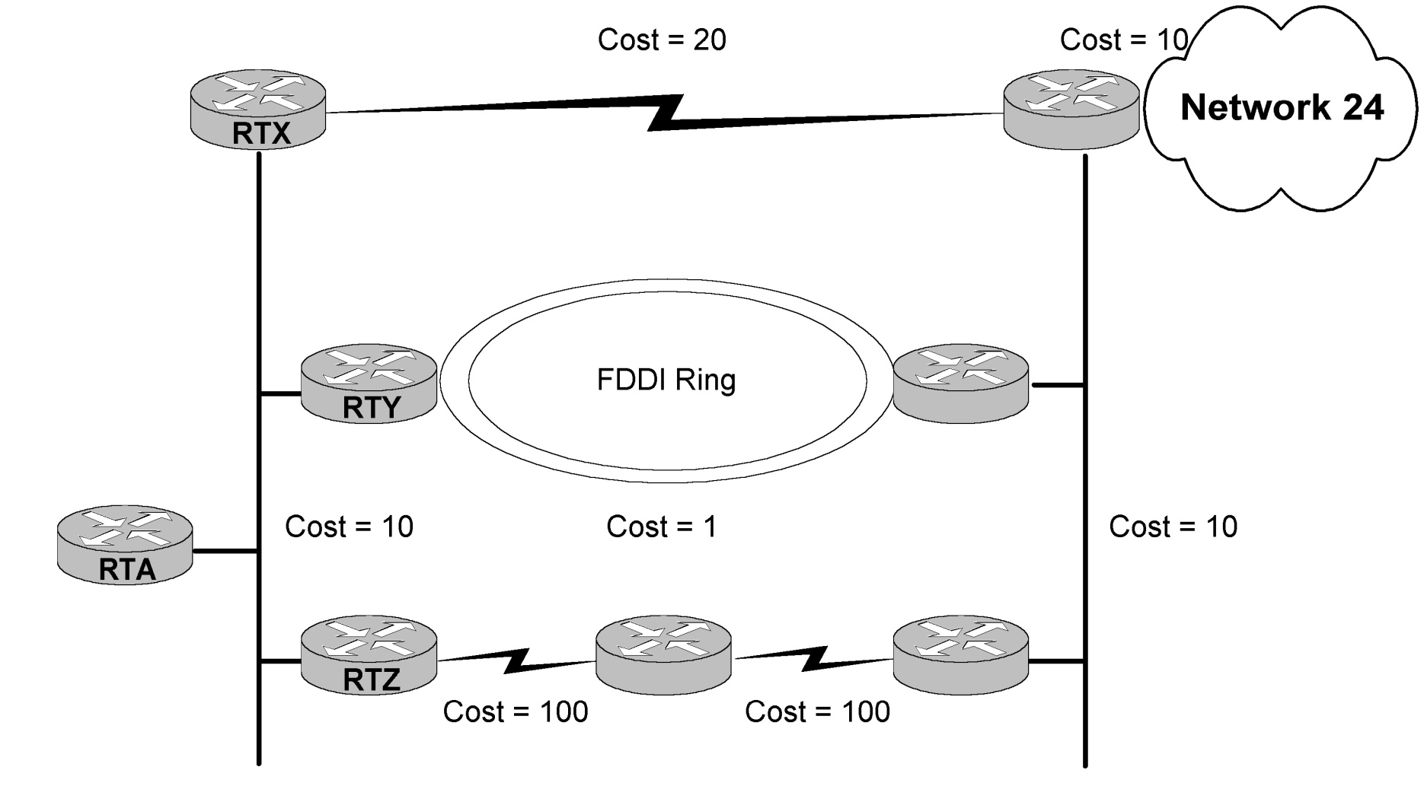
DUAL

Slide 38
DUAL
Neighbor
Feasible Distance to Net 24
Reported Distance to Net 24
RTY
31
21
RTZ
230
220
RTX
40
30
RTY is successor with a computed cost (feasible distance) of 31.
“31” is the Feasible Distance (FD).
RTX is a feasible successor because its RD is less than the FD.
RTZ is not a feasible successor because it’s RD (230) > RTY’s FD (31) and thus may be routed through RTY (loop ?)

Slide 39
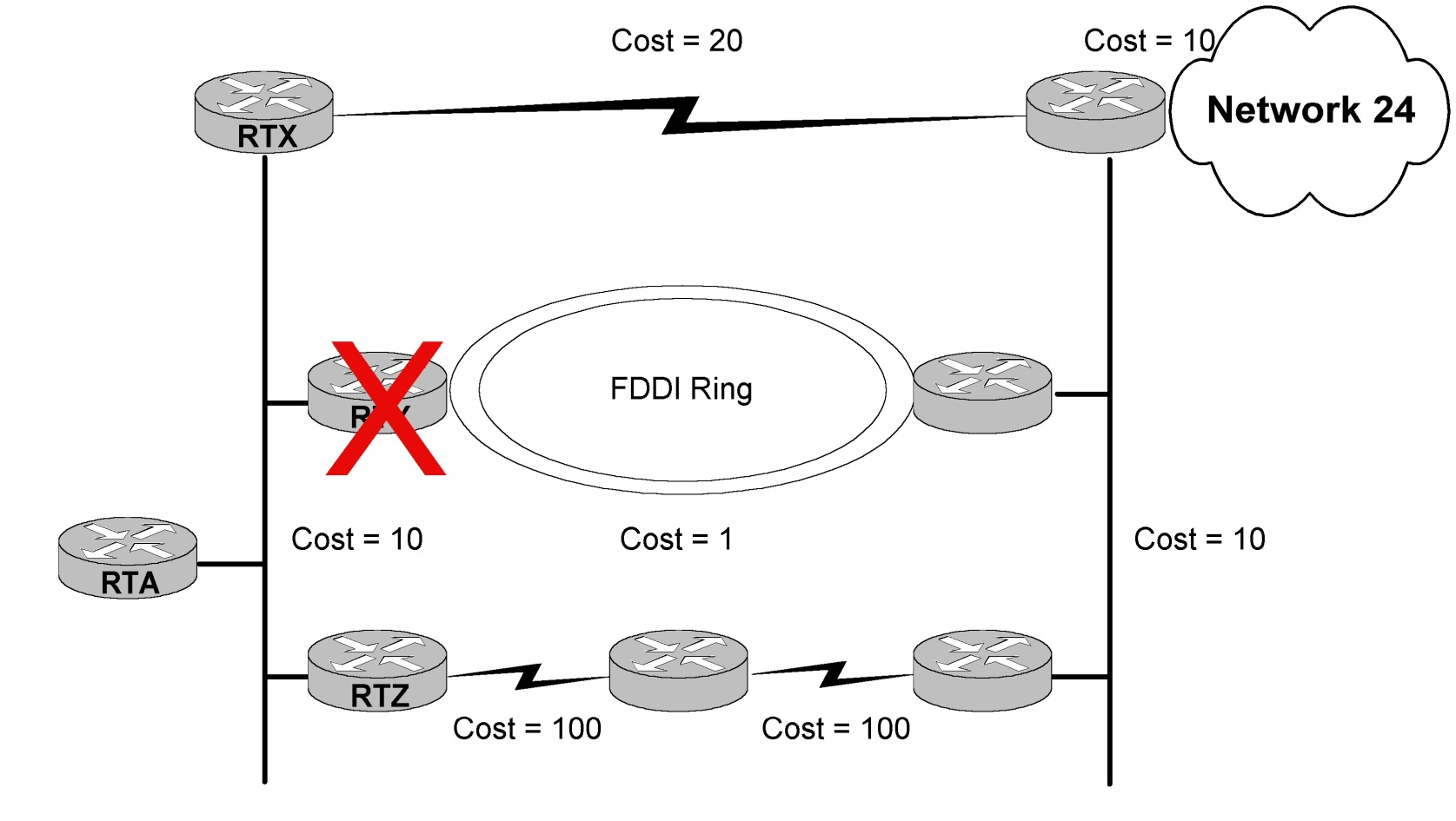
DUAL

Slide 40
DUAL
Neighbor
FD to Net 24
Reported Distance to Net 24
RTY
31
21
RTZ
230
220
RTX
40
30
Since RTX is a feasible successor, it is installed in the routing table immediately (no recomputation).
It’s RD (30) is less than the FD (31).

Slide 41
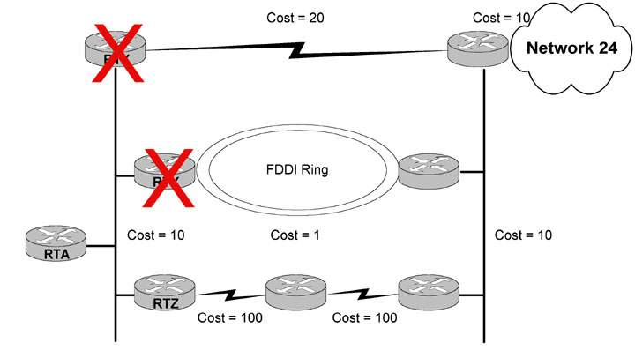
DUAL

Slide 42
DUAL
Neighbor
Computed Cost to Net 24
Reported Distance to Net 24
RTY
31
21
RTZ
230
220
RTX
40
30
RTY is not a feasible successor. It’s RD (220) is greater than the FD (31) for Net 24. Before this route can be installed, the route to net 24 must be placed in the active state and recomputed.

Slide 43
EIGRP Topology Table
When a router discovers a new neighbor, an update is sent to and received from its new neighbor populating the topology table (containing destinations advertised by all neighbors)
The topology table:
  updated when a directly connected route or interface changes or when a neighboring router reports a change to a route
  Entry for a destination exists in either active or passive state:
    Passive state: router is not performing a recomputation
    Active state: router is performing a recomputation
  Recomputation occurs when the destination has no feasible successors (initiated by sending a query packet to each of the neighboring routers

Slide 44
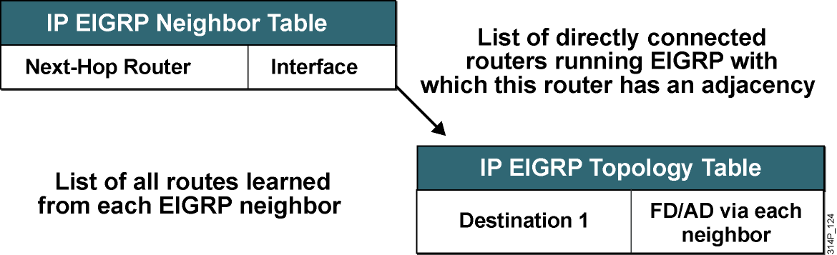
EIGRP Topology Table

Slide 45
EIGRP Neighbor Status
RTRA#show ip eigrp neighbors
IP-EIGRP neighbors for process 1
H Address Interface Hold Uptime SRTT RTO Q Seq
(sec) (ms) Cnt Num
2 10.1.1.1 Et0 12 6d16h 20 200 0 233
1 10.1.4.3 Et1 13 2w2d 87 522 0 452
0 10.1.4.2 Et1 10 2w2d 85 510 0 3
Seconds Remaining Before Declaring Neighbor Down
How Long Since the Last Time Neighbor Was Discovered
How Long It Takes for This Neighbor To Respond To Reliable Packets
How Long to Wait Before Retransmitting If No Acknowledgement
Notes:
How EIGRP uses these tables:
EIGRP uses the Neighbor table to list adjacent routers.
Topology table lists all learned routes to each destination
Routing table contains the best route (successor route) and backup route (feasible successor route)
When a neighbor adjacency is formed, it records the neighbor’s address and the interface through which it can be reached as an entry in the neighbor table.
One neighbor table exists for each protocol-dependent module.
The EIGRP neighbor table is comparable to the adjacencies database that link-state routing protocols use and serves the same purpose: to ensure bidirectional communication between each of the directly connected neighbors.
When the hello packet is sent, it advertises a hold time (time a router reports a neighbor as reachable and operational). If a hello packet from a neighboring router is not received within the hold time, it expires, and DUAL is informed of the topology change.
The neighbor-table includes information required by RTP.
Sequence numbers are used to match acknowledgments with data packets (helping to check out-of-order packets).
transmission list is used to queue packets for possible retransmission on a per-neighbor basis.
Round-trip timers are kept in the neighbor-table entry to estimate an optimal retransmission interval.

Slide 46
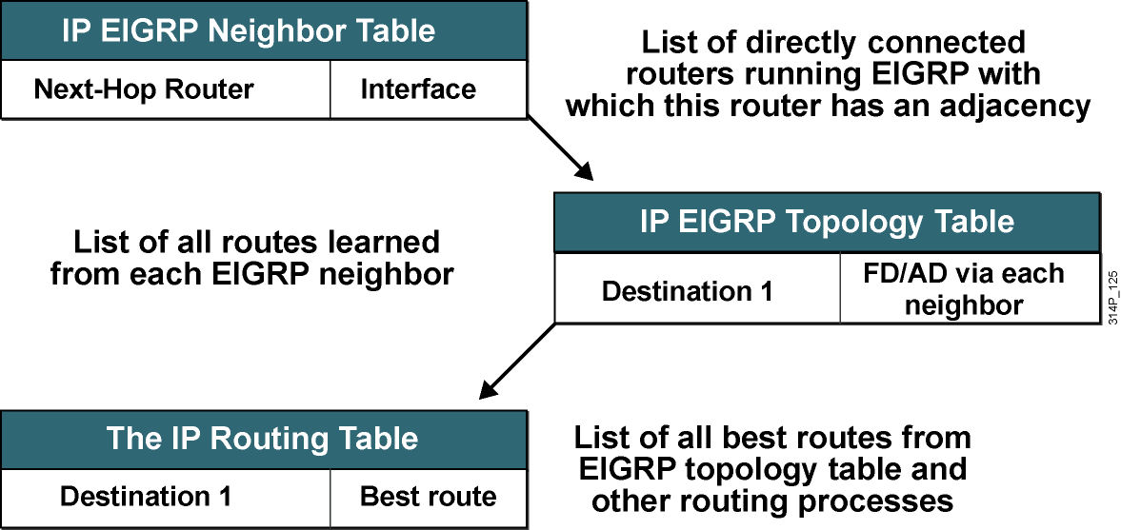
EIGRP IP Routing Table
Notes:
A router compares all Feasible Distances (FDs) to reach a specific network and then selects the route with the lowest FD and places it in the IP routing table; this is the successor route. The FD for the chosen route becomes the EIGRP routing metric to reach that network in the routing table.

Slide 47
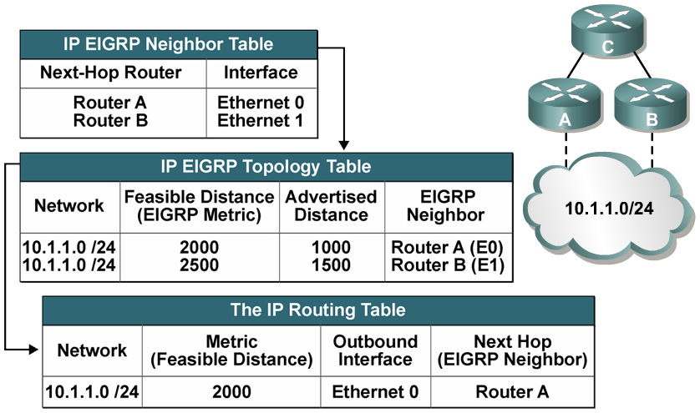
Example: EIGRP Tables
Router C’s tables:
Notes:
The network shown illustrates router C’s EIGRP tables. Routers A and B have established a neighbor relationship with router C. Both routers A and B have paths to network 10.1.1.0/24, among many others that are not shown.
Router A has an EIGRP metric of 1000 for 10.1.1.0/24, so router A advertises 10.1.1.0/24 to router C with a metric of 1000. Router C installs the route to 10.1.1.0/24 via router A in its EIGRP topology table with an advertised distance of 1000.
Router B has network 10.1.1.0/24 with a metric of 1500 in its IP routing table, so router B advertises 10.1.1.0/24 to router C with an advertised distance of 1500. Router C places the route to 10.1.1.0/24 network via router B in the EIGRP topology table with an advertised distance of 1500.
Router C has two entries to reach 10.1.1.0/24 in its topology table. The EIGRP metric for router C to reach both routers A and B is 1000. This cost (1000) is added to the respective advertised distance from each router, resulting in the feasible distances from router C to reach network 10.1.1.0/24 shown in the figure.
Router C chooses the least-cost feasible distance, which is 2000, via router A, and installs it in the IP routing table as the best route to reach 10.1.1.0/24. The EIGRP metric in the routing table is equal to the feasible distance from the EIGRP topology table. Router A is the successor for the route to 10.1.1.0/24.

Slide 48
EIGRP Packets
Hello: Establish neighbor relationships.
Update: Send routing updates
Query: Ask neighbors about routing information
Reply: Respond to query about routing information
ACK: Acknowledge a reliable packet

Slide 49
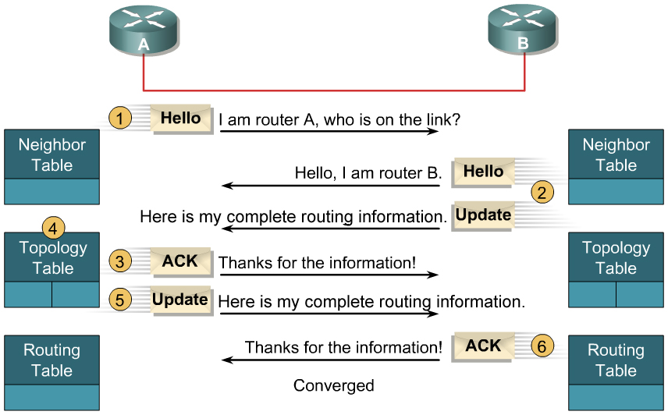
Initial Route Discovery

Slide 50
EIGRP Metric
Same metric components as IGRP:
  Bandwidth
  Delay
  Reliability
  Loading
  MTU (Maximum Transmission Unit)
EIGRP metric is IGRP metric multiplied by 256

Slide 51
EIGRP Metric
This metric can be based on five criteria, but EIGRP uses only two of these criteria by default:
Bandwidth: The smallest bandwidth between source and destination
Delay: The cumulative interface delay along the path
Other criteria can be used, but are not recommended, because they typically result in frequent recalculation of the topology table:
Reliability: This value represents the worst reliability between source and destination, based on keepalives.
Loading: This value represents the worst load on a link between source and destination, computed based on the packet rate and the configured bandwidth of the interface.
MTU: This criterion represents the smallest MTU in path. MTU is included in the EIGRP routing update but is not actually used in the metric calculation.

Slide 52
EIGRP Metric Calculation
By default, EIGRP metric:
  Metric = bandwidth (slowest link) + delay (sum of delays)
Delay = sum of the delays in the path, in tens of microseconds, multiplied by 256.
Bandwidth = [10⁷ / (minimum bandwidth link along the path, in kilobits per second)] * 256

Slide 53
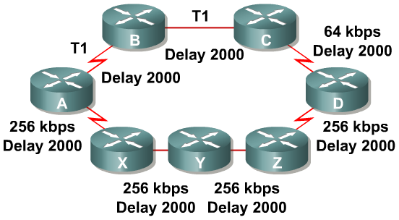
EIGRP Metrics Calculation Example
A → B → C → D Least bandwidth 64 kbps Total delay 6,000
A → X → Y → Z → D Least bandwidth 256 kbps Total delay 8,000
  Delay is the sum of all the delays of the links along the paths:
  Delay = [delay in tens of microseconds] x 256
  BW is the lowest bandwidth of the links along the paths:
  BW = [10,000,000 / (bandwidth in kbps)] x 256

Slide 54
LAB
Configuration of Dyanamic Routing-EIGRP

Slide 55
OSPF

Slide 56
Characteristics of OSPF’s hierarchical design
First, let’s start with a review of the characteristics of OSPF’s hierarchical design.
Recall that OSPF allows for the creation of multiple areas so that the network
administrator can:
Reduce the size of routing tables
Isolate topology changes as much as possible to the area in which they occur
Allow only summary Link state advertisements (LSA) updates to cross area boundaries and Reap all the benefits of using a hierarchical addressing scheme.

Slide 57
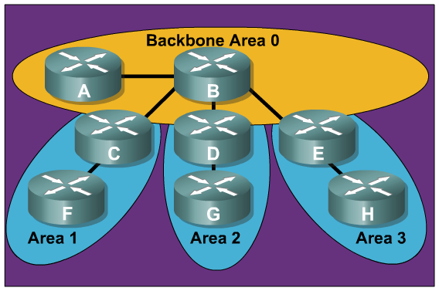
OSPF Areas
Review of OSPF area characteristics:
  Minimizes routing
  table entries
  Localizes impact of
  a topology change
  within an area
  Detailed Link State Advertisement (LSA)
  flooding stops at
  the area boundary
  Requires a
  hierarchical
  network design

Slide 58

OSPF Areas
New terminology for areas:
  Transit Area:
    Also known as Backbone Area 0
  Regular Area:
    Also known as Nonbackbone areas

Slide 59
OSPF Areas
The backbone area is also referred to as a transit area.
Another type of transit area is one that is configured with virtual links.
Virtual links are a temporary solution when an organization has two backbones that are physically and logically disconnected.
A virtual link between the two backbones is also called a transit area.
All other areas are known as regular areas (standard areas, stub areas, totally stubby areas, and NSSAs)

Slide 60
OSPF Database
OSPF maintains three databases
Adjacency Database (show ip ospf neighbor)
Link-state Database (show ip ospf database)
Forwarding Database (show ip route)

Slide 61
OSPF Database
Remember that OSPF uses three databases in its operation:
The Adjacency Database is a table listing all OSPF neighbors with which the local router has established bidirectional communication. Display this table with the show ip ospf neighbor command.
The Link-state Database is a table listing all other routers in the network. This database shows the network topology. All OSPF routers in the same area have identical Link-state Databases. Display this table with the show ip ospf database command.
The Forwarding Database is simply the routing table. It includes a list of all routes generated when the SPF algorithm is calculated on the Link-state Database. Display this table with the show ip route command.

Slide 62
What is LSDB?
LSDB is an acronym for Link-state Database.
LSAs and the Link-state Database

Slide 63
LSA Sequence Numbering
Each LSA in the LSDB maintains a sequence number.
The sequence numbering scheme is a 4-byte number that begins with 0x80000001 and ends with 0x7…..F.
OSPF floods each LSA every 30 minutes to maintain proper database synchronization. Each time the LSA is flooded, the sequence number is incremented by one.
Ultimately, an LSA sequence number will wrap around to 0x80000001. When this occurs, the existing LSA is prematurely aged to maxage (one hour) and flushed.
When a router encounters two instances of an LSA, it must determine which is more recent. The LSA having the newer (higher) LS sequence number is more recent.

Slide 64
The OSPF Link-State Database
The show ip ospf database command displays the current LSDB for the local router.
.
RTC#show ip ospf database
OSPF Router with ID (192.168.1.253) (Process ID 3)
Router Link States (Area 0)
Link ID ADV Router Age Seq# Checksum Link count
192.168.1.249 192.168.1.249 1705 0x80000005 0x00D5B0 5
192.168.1.253 192.168.1.253 1578 0x80000006 0x009F91 5

Slide 65
Verifying LSA Age and Sequence Number
In the first output below, notice the age timer will expire sometime after 1800 seconds or 30 minutes.
RTC#show ip ospf database
OSPF Router with ID (192.168.1.253) (Process ID 3)
Router Link States (Area 0)
Link ID ADV Router Age Seq# Checksum Link count
192.168.1.249 192.168.1.249 1705 0x80000005 0x00D5B0 5
192.168.1.253 192.168.1.253 1578 0x80000006 0x009F91 5
A few minutes later, the router has received an LSU for both links. Note the refreshed age timer and incremented sequence number.
RTC#show ip ospf database
OSPF Router with ID (192.168.1.253) (Process ID 3)
Router Link States (Area 0)
Link ID ADV Router Age Seq# Checksum Link count
192.168.1.249 192.168.1.249 106 0x80000006 0x00D3B1 5
192.168.1.253 192.168.1.253 58 0x80000007 0x009D92 5

Slide 66
Basic OSPF Configuration

Slide 67
Configuring OSPF
An excellent resource for information on the many different OSPF configurations is the Cisco white paper, “Configuring OSPF”, which can be downloaded from the Cisco website:
  http://www.cisco.com/en/US/products/sw/iosswrel/ps1835/products_configuration_guide_chapter09186a00800b3f2e.html

Slide 68
Configuring Basic OSPF
Router(config)#
router ospf process-id [vrf vpn-name]
Enable one or more OSPF routing processes.
Router(config-router)#
network ip-address wildcard-mask area area-id
Define the interfaces that OSPF will run on.
Router(config-if)#
ip ospf process-id area area-id [secondaries none]
Optional method to enable OSPF explicitly on an interface.
Notes:
Step 1: Enable the OSPF process on the router using the router ospf command. The process-id is an internally used number to identify the OSPF routing process. The process ID does not need to match process IDs on other routers. Running multiple OSPF processes on the same router is not recommended because it creates multiple database instances that add extra overhead.
However, if you are routing for multiple VPN routing and forwarding instances, the each VRF needs its own routing process. The vrf vpn-name option specifies the name of the VPN routing and forwarding (VRF) instance to associate with OSPF VRF processes. For more information on configuring VRF and OSPF refer to the following Cisco link:
http://www.cisco.com/en/US/products/ps6350/products_configuration_guide_chapter09186a008045577b.html
Step 2: Identify which interfaces on the router are part of the OSPF process, using the
network command, as shown in the figure. We are all familiar with this command.
The ip ospf process-id area area-id interface command is a completely new command starting with Cisco IOS Release 12.3(11)T. With this command, you can enable OSPF directly on an interface, which simplifies the configuration of unnumbered interfaces. Because the command is configured explicitly for the interface, it will take precedence over the network area command. The secondaries none option will prevent secondary IP addresses on the interface from being advertised.

Slide 69
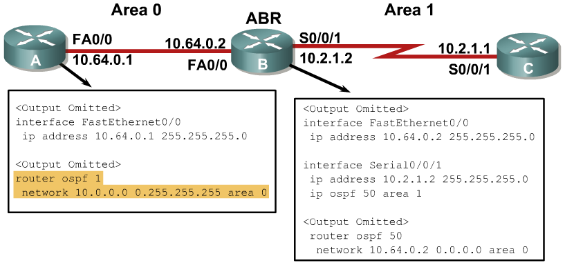
Configuring OSPF for Multiple Areas
Example: Configuring OSPF for Multiple Areas
The figure shows an example of multiarea OSPF configuration. Router A is in area 0, router C is in area 1, and router B is the area border router (ABR) between the two areas.
The configuration for router A is nothing new. However although Router B has a network statement for area 0 within the OSPF routing process, notice that the configuration for area 1 uses the ip ospf 50 area 1 command on the interface.
Alternatively, we could have used a separate network router configuration command in the OSPF routing process.

Slide 70
OSPF Router ID
The router is known to OSPF by the OSPF router ID number
LSDBs use the OSPF router ID to differentiate one router from the next.
By default, the router ID is the highest IP address on an active interface at the moment of OSPF process startup.
  If no interface is up when the OSPF process starts, you will get the following error message:
  p5r2(config)#router ospf 1
  2w1d: %OSPF-4-NORTRID: OSPF process 1 cannot start.
A loopback interface can override the OSPF router ID. If a loopback interface exists, the router ID is the highest IP address on any active loopback interface.
The OSPF router-id command can be used to override the OSPF router ID.
Using a loopback interface or a router-id command is recommended for stability.

Slide 71
OSPF router-id Command
Router(config-router)#
router-id ip-address
  This command is configured under the router ospf [process-id] command.
  Any unique arbitrary 32-bit value in an IP address format (dotted decimal) can be used.
  If this command is used on an OSPF process that is already active, then the new router ID takes effect after the next reload or after a manual restarting of the OSPF process using:
Router#clear ip ospf process
Router(config)#router ospf 1
Router(config-router)#router-id 172.16.1.1
Router#clear ip ospf process

Slide 72
Virtual Link Concepts and Configuration

Slide 73
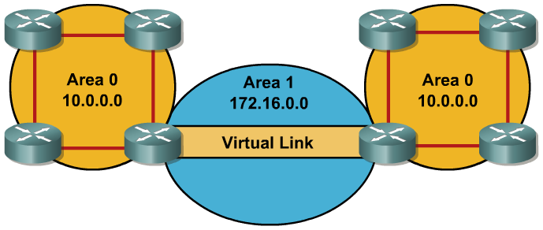
Virtual Links
Virtual links are used to connect a discontiguous area to area 0.
A logical connection is built between router A and router B.
Virtual links are recommended for backup or temporary connections.

Slide 74
Special Treatment for LSAs on Virtual Links
LSAs usually age out after 30 minutes
LSAs learned across virtual links have the DoNotAge (DNA) option set
Required to prevent excessive flooding over virtual links

Slide 75
Configuring Virtual Links
Router(config-router)#
area area-id virtual-link router-id [authentication [message-digest | null]] [hello-interval seconds] [retransmit-interval seconds] [transmit-delay seconds] [dead-interval seconds] [[authentication-key key] | [message-digest-key key-id md5 key]]
Creates a virtual link
Optional parameters are used in place of interface ip ospf commands
Notes:
We are already familiar with how to configure a basic virtual link. Simply use the area area-id virtual-link router-id router configuration command on each side of the link to define an OSPF virtual link. However, notice all the optional parameters that we can configure for the virtual link. If necessary for the virtual link, authentication and timing intervals must be configured here because the link is virtual. The equivalent ip ospf commands on the physical interface will not apply to traffic on the virtual link.

Slide 76
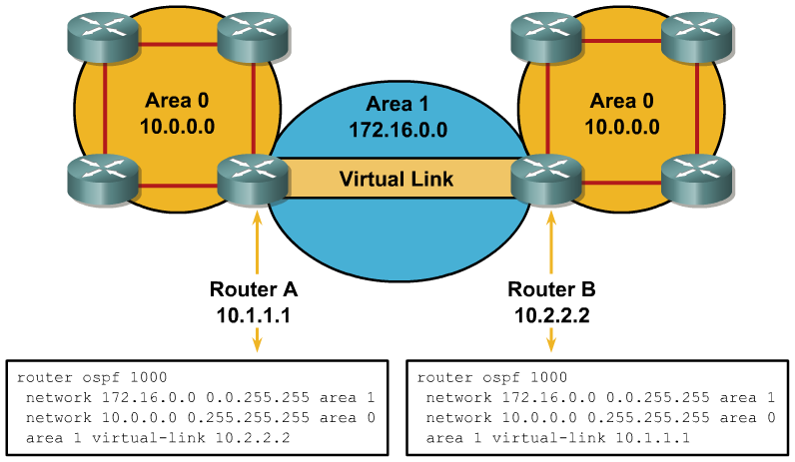
Configuring and Verifying a Virtual Link
RouterA#sh ip ospf virtual-links
Virtual Link OSPF_VL0 to router 10.2.2.2 is up
Run as demand circuit
DoNotAge LSA allowed.
Transit area 1, via interface Serial0/0/1, Cost of using 781
Transmit Delay is 1 sec, State POINT_TO_POINT,
Timer intervals configured, Hello 10, Dead 40, Wait 40, Retransmit 5
Hello due in 00:00:07
Adjacency State FULL (Hello suppressed)
Index 1/2, retransmission queue length 0, number of retransmission 1
First 0x0(0)/0x0(0) Next 0x0(0)/0x0(0)
Last retransmission scan length is 1, maximum is 1
Last retransmission scan time is 0 msec, maximum is 0 msec

Slide 77
OSPF Authentication

Slide 78
OSPF Authentication Types
  OSPF supports 2 types of authentication:
    Simple password authentication (plain text)
    MD5 authentication
  Router generates and checks each packet and authenticates the source of each update packet it receives
  Configure a “key” (password)
    Note: all participating neighbors must have the same key configured

Slide 79
Configuring Simple Password Authentication
Router(config-if)#
ip ospf authentication-key password
Assign a password to be used with neighboring routers.
Router(config-if)#
ip ospf authentication [message-digest | null]
Specifies the authentication type for an interface (since IOS 12.0).
Router(config-router)#
area area-id authentication [message-digest]
Specifies the authentication type for an area (was in IOS before 12.0).

Slide 80
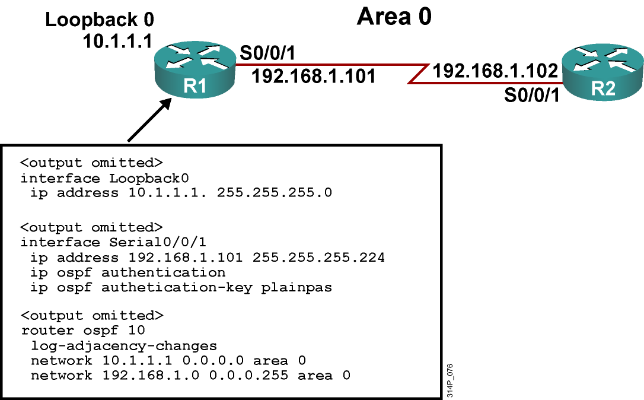
Example Simple Password Authentication Configuration
Notes:
The figure shows the network used to illustrate the configuration, verification, and troubleshooting of simple password authentication in the next few slides. The configuration of the R1 router is shown in this figure as well.
Simple password authentication is configured on interface serial 0/0/1 with the ip ospf authentication command. The interface is configured with an authentication key of plainpas.

Slide 81
R2 Configuration for Simple Password Authentication
<output omitted>
interface Loopback0
ip address 10.2.2.2 255.255.255.0
<output omitted>
interface Serial0/0/1
ip address 192.168.1.102 255.255.255.224
ip ospf authentication
ip ospf authentication-key plainpas
<output omitted>
router ospf 10
log-adjacency-changes
network 10.2.2.2 0.0.0.0 area 0
network 192.168.1.0 0.0.0.255 area 0
Notes:
Simple password authentication is configured on interface serial 0/0/1 with the ip ospf authentication command. The interface is configured with an authentication key of plainpas. Notice that the connecting interfaces on both R1 and R2 are configured for the same type of authentication with the same authentication key.

Slide 82
Verifying Simple Password Authentication
R1#sh ip ospf neighbor
Neighbor ID Pri State Dead Time Address Interface
10.2.2.2 0 FULL/ - 00:00:32 192.168.1.102 Serial0/0/1
R1#show ip route
<output omitted>
Gateway of last resort is not set
10.0.0.0/8 is variably subnetted, 2 subnets, 2 masks
O 10.2.2.2/32 [110/782] via 192.168.1.102, 00:01:17, Serial0/0/1
C 10.1.1.0/24 is directly connected, Loopback0
192.168.1.0/27 is subnetted, 1 subnets
C 192.168.1.96 is directly connected, Serial0/0/1
R1#ping 10.2.2.2
Type escape sequence to abort.
Sending 5, 100-byte ICMP Echos to 10.2.2.2, timeout is 2 seconds:
!!!!!
Success rate is 100 percent (5/5), round-trip min/avg/max = 28/29/32 ms
Notes:
The figure shows the output of the show ip ospf neighbor and show ip route commands.
The neighbor state is FULL, indicating that the two routers have successfully formed an OSPF adjacency. The routing table verifies that the 10.2.2.2 address has been learned via OSPF over the serial connection.
The results of a ping to the R2 loopback interface address is also displayed to illustrate that the link is working.

Slide 83
Configuring OSPF MD5 Authentication
Router(config-if)#
ip ospf message-digest-key key-id md5 key
Assign a key ID and key to be used with neighboring routers.
Router(config-if)#
ip ospf authentication [message-digest | null]
Specifies the authentication type for an interface (since IOS 12.0).
Router(config-router)#
area area-id authentication [message-digest]
Specifies the authentication type for an area (was in IOS before 12.0).
Notes:
MD5 authentication involved a 2-step process. To configure OSPF MD5 authentication, complete the following steps:
Assign a key ID and key to be used with neighboring routers that are using the OSPF MD5 authentication, using the ip ospf message-digest-key command, as shown in the figure.
The key and the key-id specified in this command are used to generate a message digest (also called a hash) of each OSPF packet; the message digest is appended to the packet. A separate password can be assigned to each network on a per-interface basis. The key-id allows for uninterrupted transitions between keys, which is helpful for administrators who wish to change the OSPF password without disrupting communication.
The router will stop sending duplicate packets once it detects that all of its neighbors have adopted the new key.
The process of changing keys is as follows. Suppose the current configuration is as follows:
interface FastEthernet 0/0
ip ospf message-digest-key 100 md5 OLD
Change the configuration to the following:
interface FastEthernet 0/0
ip ospf message-digest-key 101 md5 NEW
The system assumes its neighbors do not have the new key yet, so it begins a rollover process. Rollover allows neighboring routers to continue communication while the network administrator is updating them with the new key. Rollover stops once the local system finds that all its neighbors know the new key. The system detects that a neighbor has the new key when it receives packets from the neighbor authenticated by the new key.
Cisco recommends that you not keep more than one key per interface. Every time you add a new key, you should remove the old key to prevent the local system from continuing to communicate with a hostile system that knows the old key.
Specify the authentication type using the ip ospf authentication command as shown in the figure. The parameters for this command are as described in the previous topic. For MD5 authentication, use the ip ospf authentication command with the message-digest parameter. Before using this command, configure the message digest key for the interface with the ip ospf message-digest-key command.
Recall that the ip ospf authentication command was introduced in Cisco IOS Software Release 12.0. As it is for simple password authentication, the MD5 authentication type for an area is still supported using the area area-id authentication message-digest router configuration command, for backward compatibility.
NOTE: Limit to interfaces where attacks are possible

Slide 84
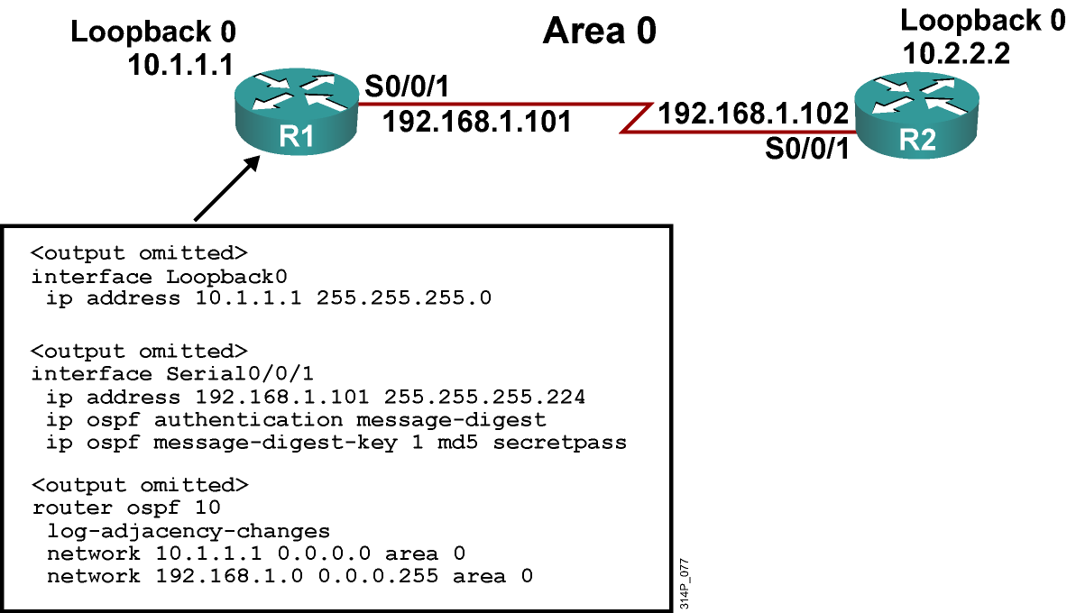
Example MD5 Authentication Configuration

Slide 85
R2 Configuration for MD5 Authenticaiton
<output omitted>
interface Loopback0
ip address 10.2.2.2 255.255.255.0
<output omitted>
interface Serial0/0/1
ip address 192.168.1.102 255.255.255.224
ip ospf authentication message-digest
ip ospf message-digest-key 1 md5 secretpass
<output omitted>
router ospf 10
log-adjacency-changes
network 10.2.2.2 0.0.0.0 area 0
network 192.168.1.0 0.0.0.255 area 0

Slide 86
Verifying MD5 Authentication
R1#sho ip ospf neighbor
Neighbor ID Pri State Dead Time Address Interface
10.2.2.2 0 FULL/ - 00:00:31 192.168.1.102 Serial0/0/1
R1#show ip route
<output omitted>
Gateway of last resort is not set
10.0.0.0/8 is variably subnetted, 2 subnets, 2 masks
O 10.2.2.2/32 [110/782] via 192.168.1.102, 00:00:37, Serial0/0/1
C 10.1.1.0/24 is directly connected, Loopback0
192.168.1.0/27 is subnetted, 1 subnets
C 192.168.1.96 is directly connected, Serial0/0/1
R1#ping 10.2.2.2
Type escape sequence to abort.
Sending 5, 100-byte ICMP Echos to 10.2.2.2, timeout is 2 seconds:
!!!!!
Success rate is 100 percent (5/5), round-trip min/avg/max = 28/28/32 ms

Slide 87
Troubleshooting Simple Password Authentication
Router#
debug ip ospf adj
Displays the OSPF adjacency-related events.
R1#debug ip ospf adj
OSPF adjacency events debugging is on
R1#
<output omitted>
*Feb 17 18:42:01.250: OSPF: 2 Way Communication to 10.2.2.2 on Serial0/0/1, state 2WAY
*Feb 17 18:42:01.250: OSPF: Send DBD to 10.2.2.2 on Serial0/0/1 seq 0x9B6 opt 0x52 flag 0x7 len 32
*Feb 17 18:42:01.262: OSPF: Rcv DBD from 10.2.2.2 on Serial0/0/1 seq 0x23ED opt0x52 flag 0x7 len 32 mtu 1500 state EXSTART
*Feb 17 18:42:01.262: OSPF: NBR Negotiation Done. We are the SLAVE
*Feb 17 18:42:01.262: OSPF: Send DBD to 10.2.2.2 on Serial0/0/1 seq 0x23ED opt 0x52 flag 0x2 len 72
<output omitted>
R1#show ip ospf neighbor
Neighbor ID Pri State Dead Time Address Interface
10.2.2.2 0 FULL/ - 00:00:34 192.168.1.102 Serial0/0/1

Slide 88
Troubleshooting Simple Password Authentication Problems
Simple authentication on R1, no authentication on R2:
R1#
*Feb 17 18:51:31.242: OSPF: Rcv pkt from 192.168.1.102, Serial0/0/1 : Mismatch Authentication type. Input packet specified type 0, we use type 1
R2#
*Feb 17 18:50:43.046: OSPF: Rcv pkt from 192.168.1.101, Serial0/0/1 : Mismatch Authentication type. Input packet specified type 1, we use type 0
Simple authentication on R1 and R2, but different
passwords:
R1#
*Feb 17 18:54:01.238: OSPF: Rcv pkt from 192.168.1.102, Serial0/0/1 : Mismatch Authentication Key - Clear Text
R2#
*Feb 17 18:53:13.050: OSPF: Rcv pkt from 192.168.1.101, Serial0/0/1 : Mismatch Authentication Key - Clear Text

Slide 89
Troubleshooting MD5 Authentication
R1#debug ip ospf adj
OSPF adjacency events debugging is on
<output omitted>
*Feb 17 17:14:06.530: OSPF: Send with youngest Key 1
*Feb 17 17:14:06.546: OSPF: 2 Way Communication to 10.2.2.2 on Serial0/0/1, state 2WAY
*Feb 17 17:14:06.546: OSPF: Send DBD to 10.2.2.2 on Serial0/0/1 seq 0xB37 opt 0x52 flag 0x7 len 32
*Feb 17 17:14:06.546: OSPF: Send with youngest Key 1
*Feb 17 17:14:06.562: OSPF: Rcv DBD from 10.2.2.2 on Serial0/0/1 seq 0x32F opt 0x52 flag 0x7 len 32 mtu 1500 state EXSTART
*Feb 17 17:14:06.562: OSPF: NBR Negotiation Done. We are the SLAVE
*Feb 17 17:14:06.562: OSPF: Send DBD to 10.2.2.2 on Serial0/0/1 seq 0x32F opt 0x52 flag 0x2 len 72
*Feb 17 17:14:06.562: OSPF: Send with youngest Key 1
<output omitted>
R1#show ip ospf neighbor
Neighbor ID Pri State Dead Time Address Interface
10.2.2.2 0 FULL/ - 00:00:35 192.168.1.102 Serial0/0/1

Slide 90
Troubleshooting MD5 Authentication Problems
MD5 authentication on both R1 and R2, but R1 has key 1 and R2 has key 2, both with the same passwords:
R1#
*Feb 17 17:56:16.530: OSPF: Send with youngest Key 1
*Feb 17 17:56:26.502: OSPF: Rcv pkt from 192.168.1.102, Serial0/0/1 : Mismatch Authentication Key - No message digest key 2 on interface
*Feb 17 17:56:26.530: OSPF: Send with youngest Key 1
R2#
*Feb 17 17:55:28.226: OSPF: Send with youngest Key 2
*Feb 17 17:55:28.286: OSPF: Rcv pkt from 192.168.1.101, Serial0/0/1 : Mismatch Authentication Key - No message digest key 1 on interface
*Feb 17 17:55:38.226: OSPF: Send with youngest Key 2

Slide 91
LAB
Configuration of Dyanamic Routing-OSPF

